Slide 1

TechNest
Langlopende taak
Noa Van den Berghe

Slide 2
Inhoud
Thema
Kleurenpallet
Wireframes vs Printscreens

Slide 3

Thema
Computer hardware
Zowel professioneel als particulier

Slide 4
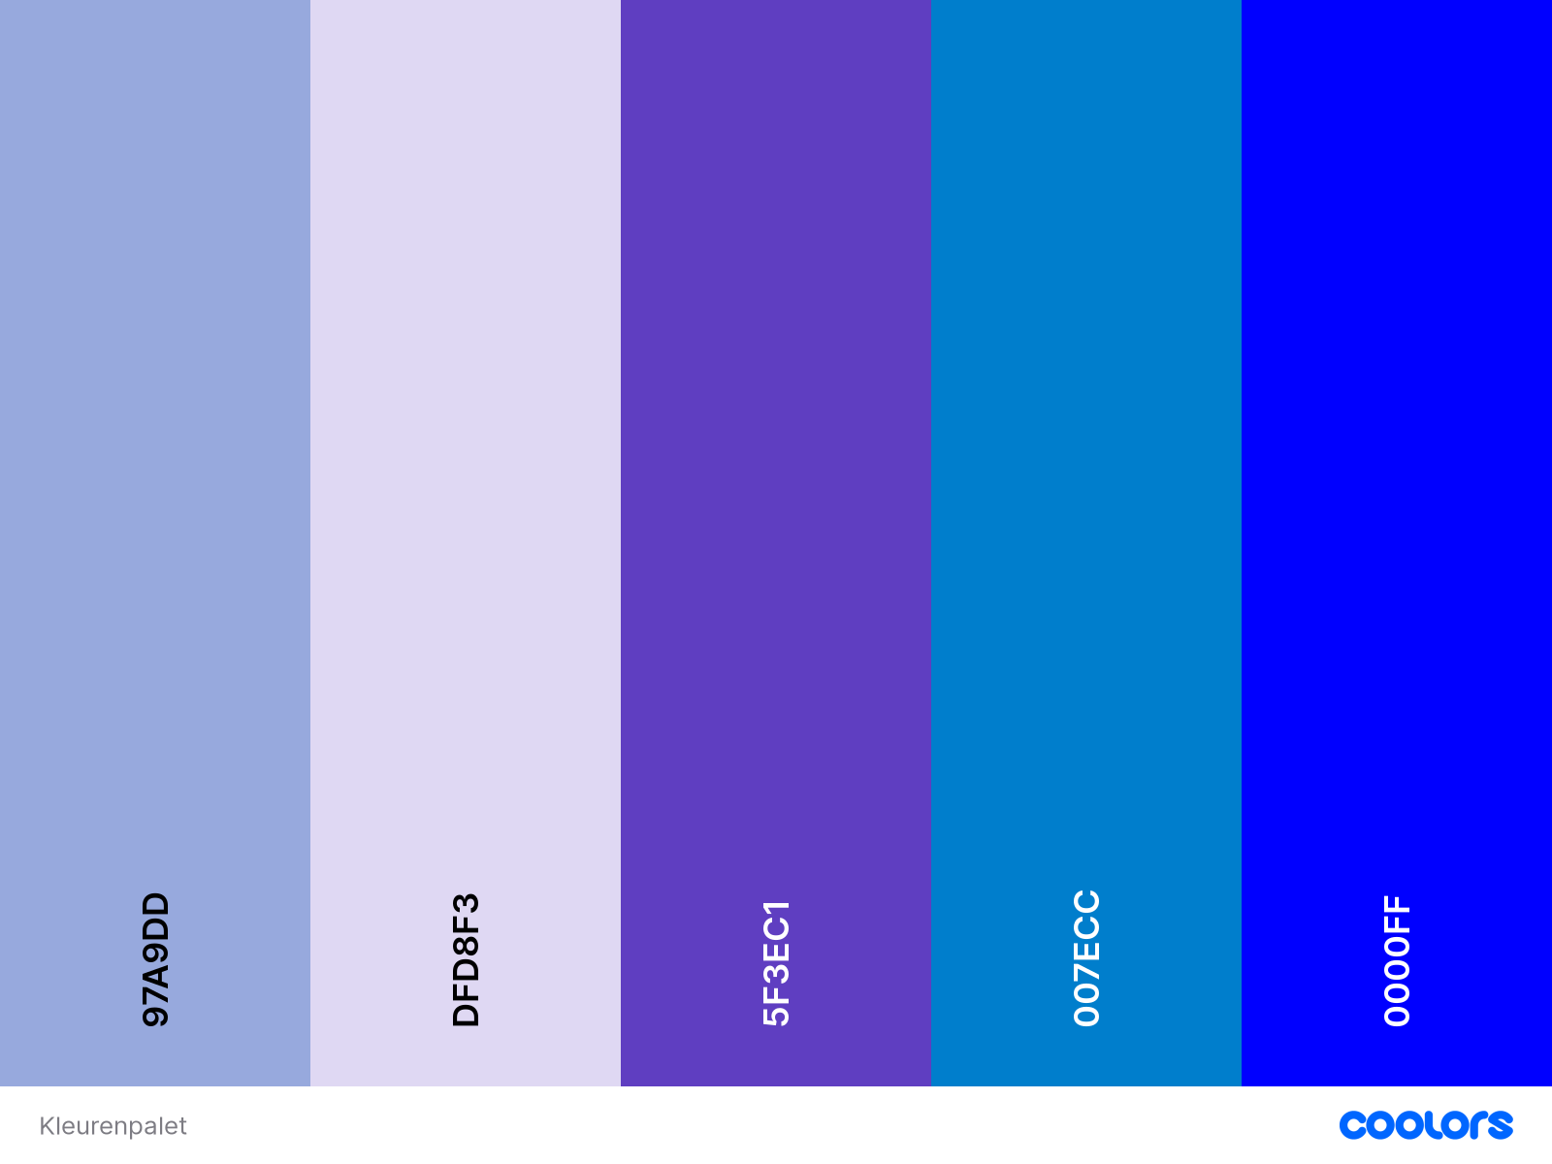
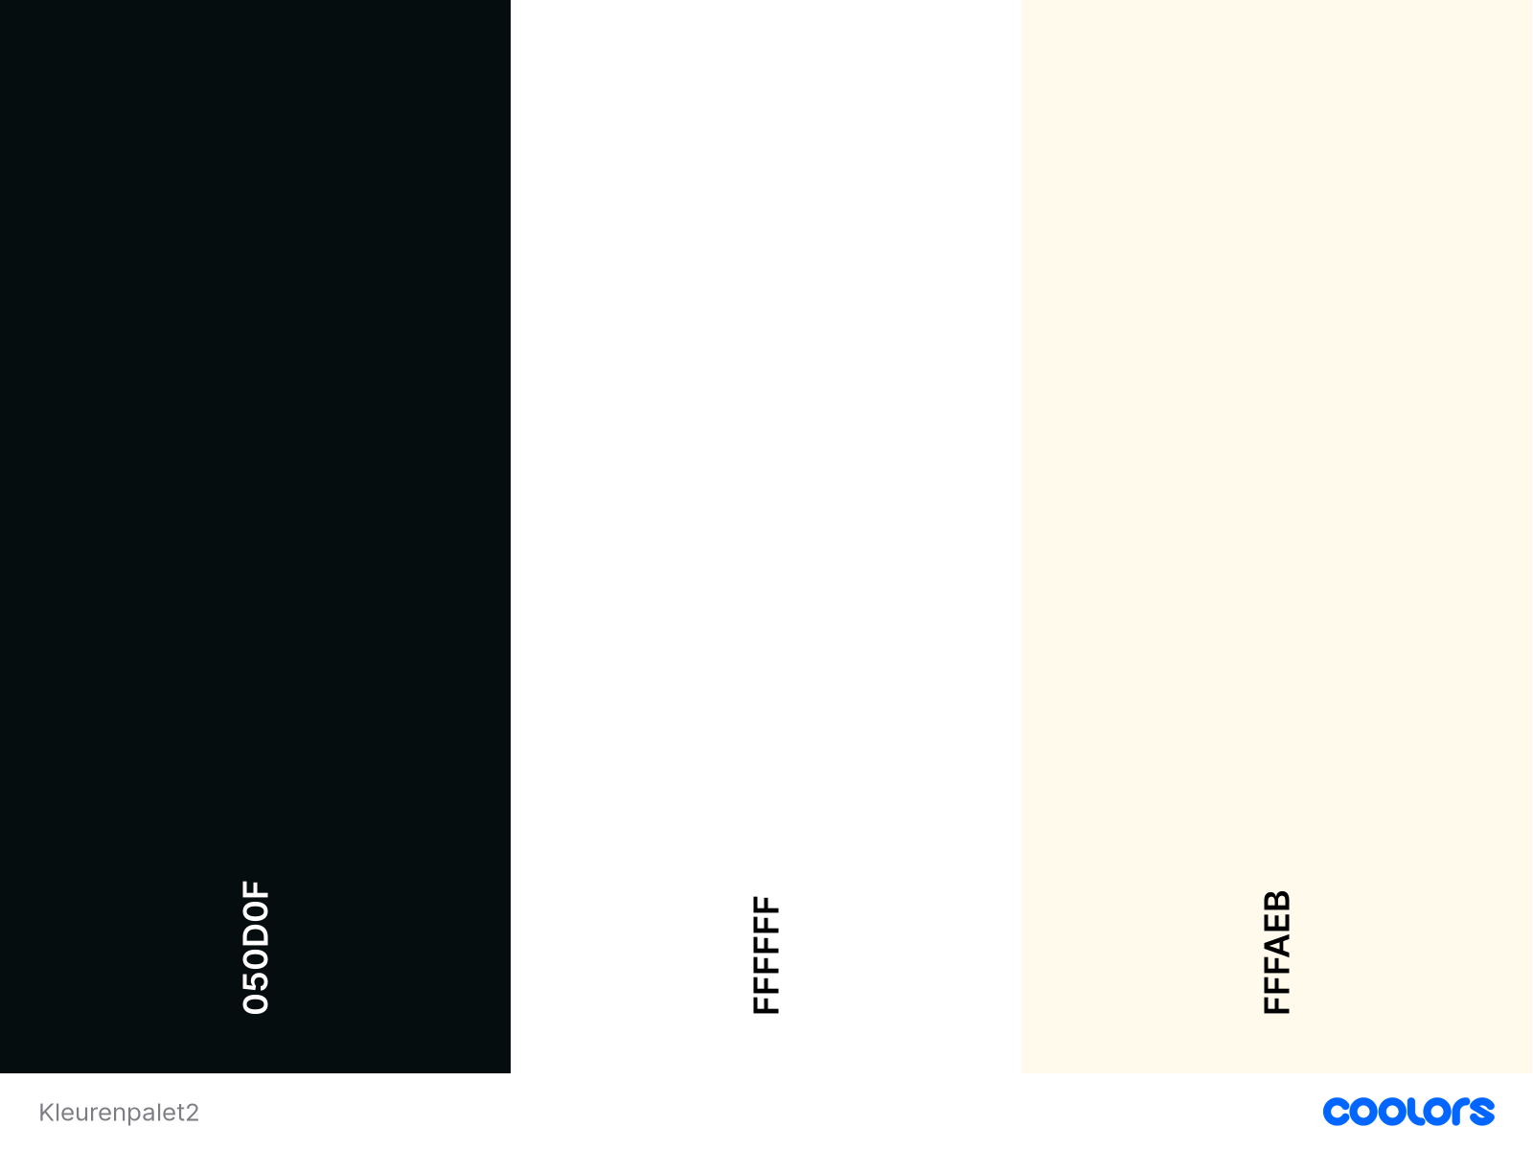
Kleurenpallet

Slide 5
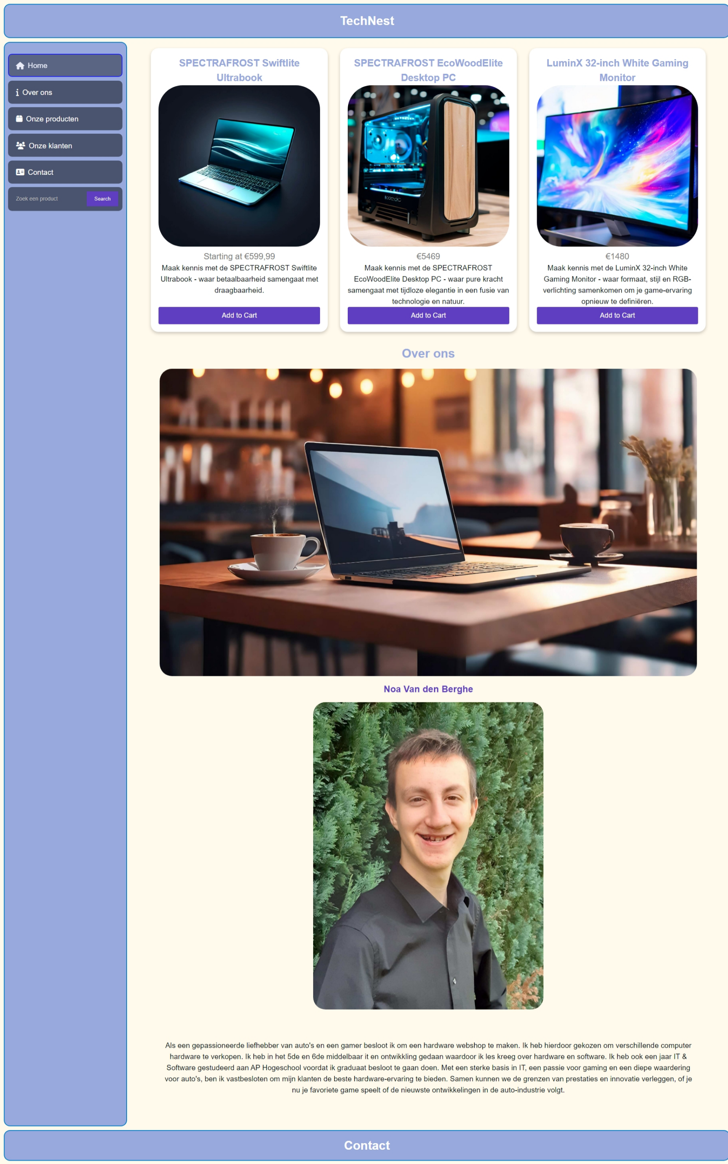

Wirerfames vs Printscreens
Home Desktop

Slide 6
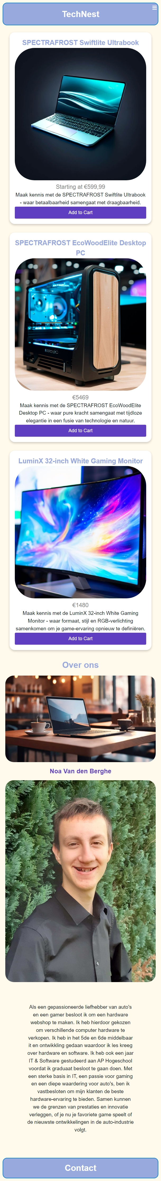
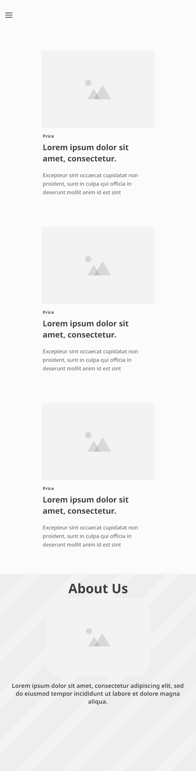
Home Mobile

Slide 7
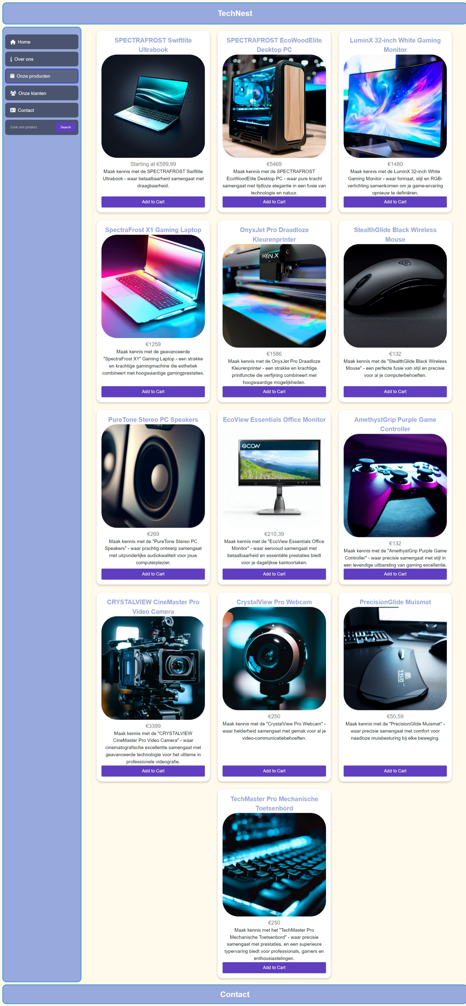
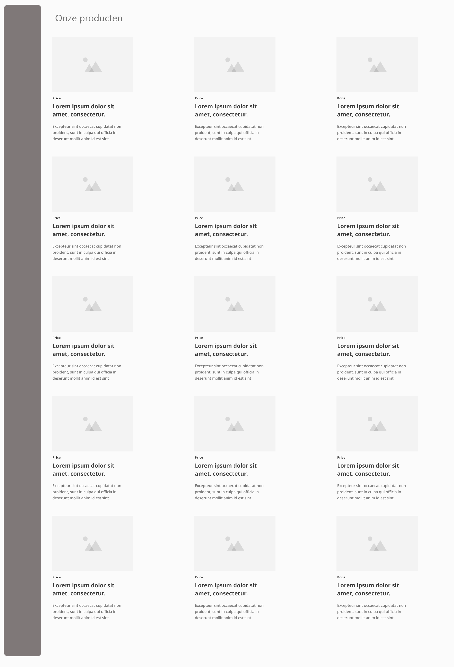
Shop Desktop

Slide 8
Shop Mobile

Slide 9
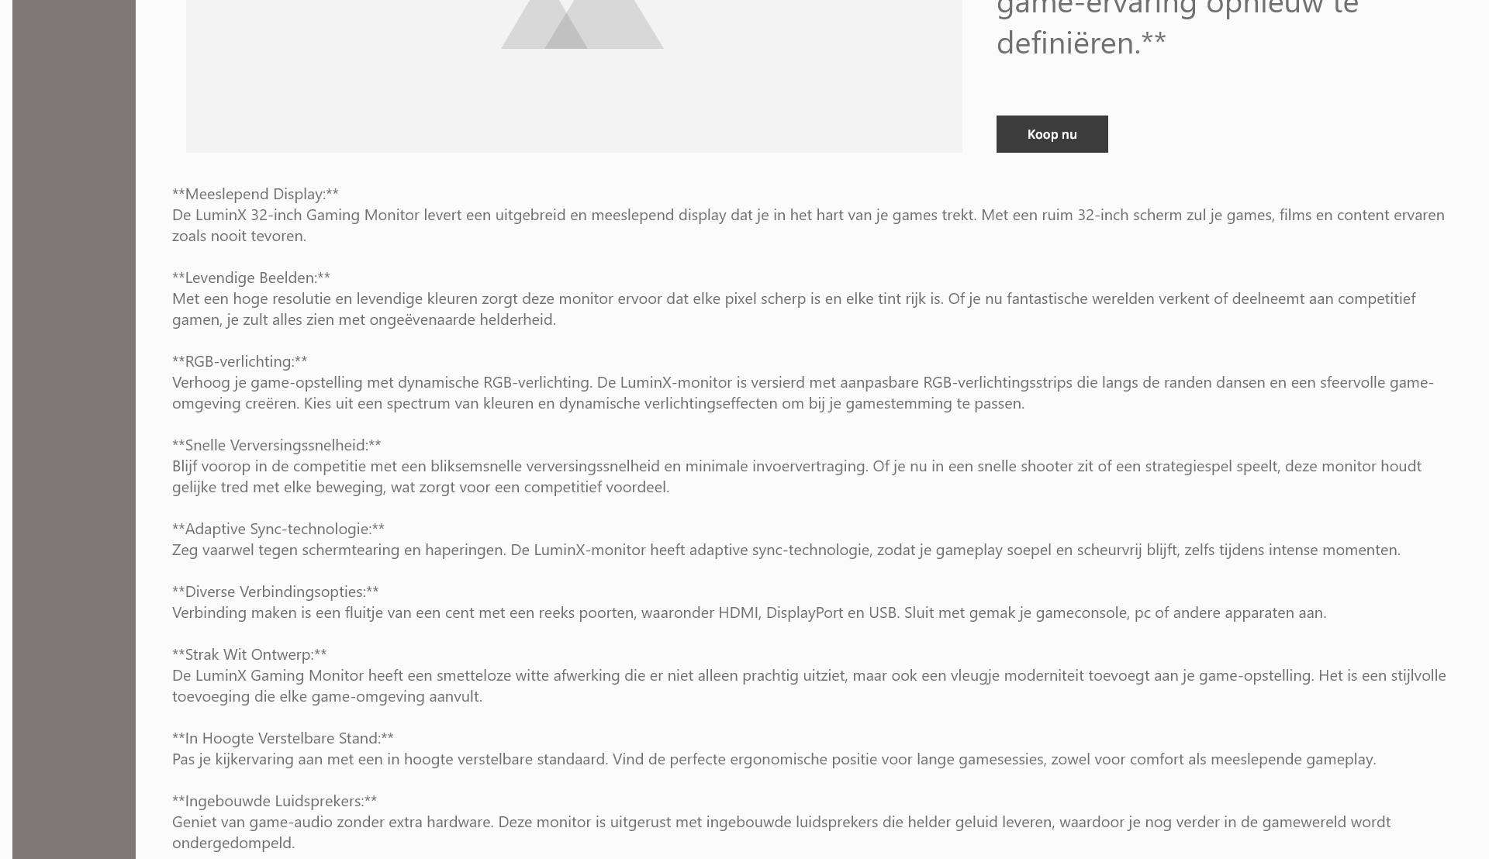
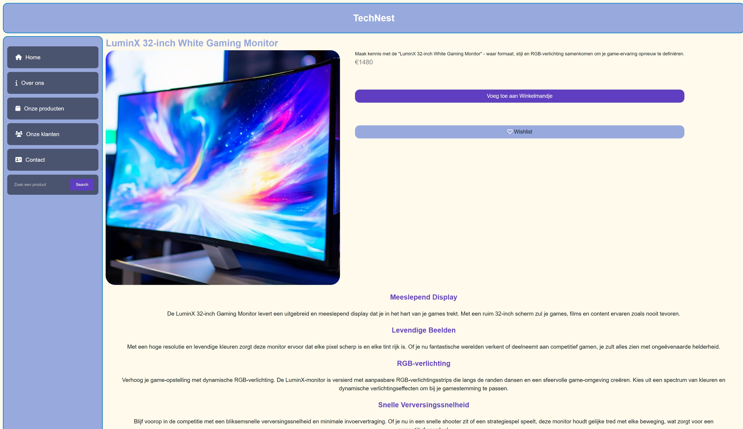
Product Desktop

Slide 10
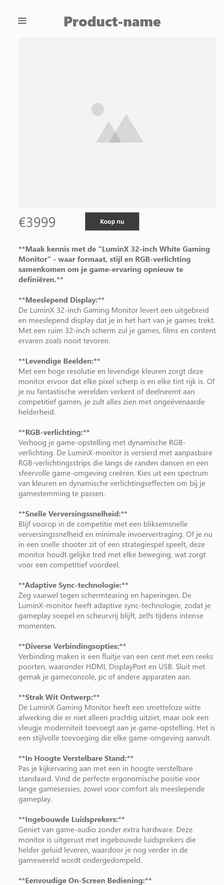
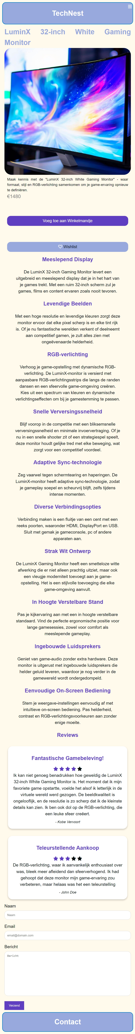
Product Mobile

Slide 11
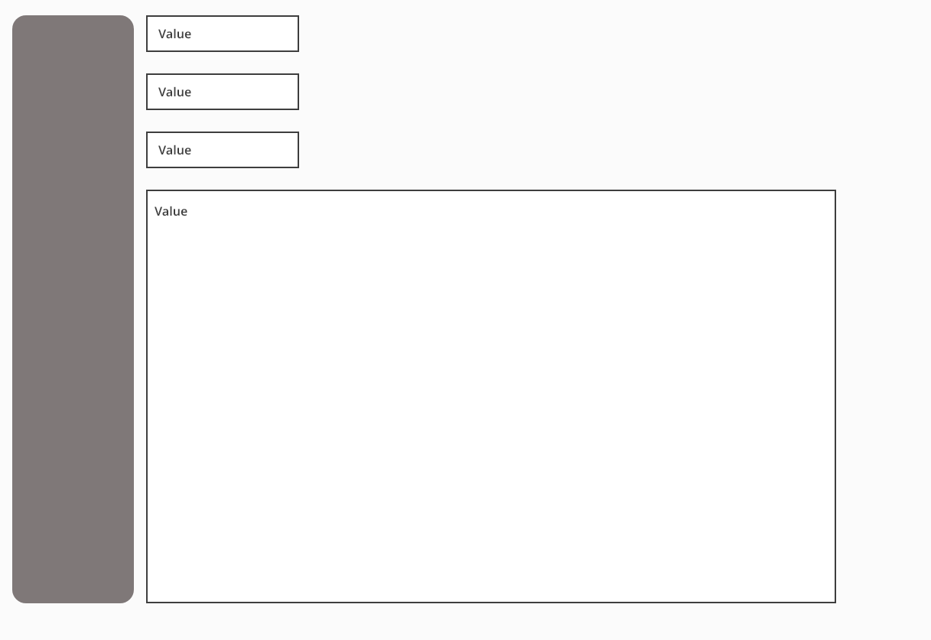
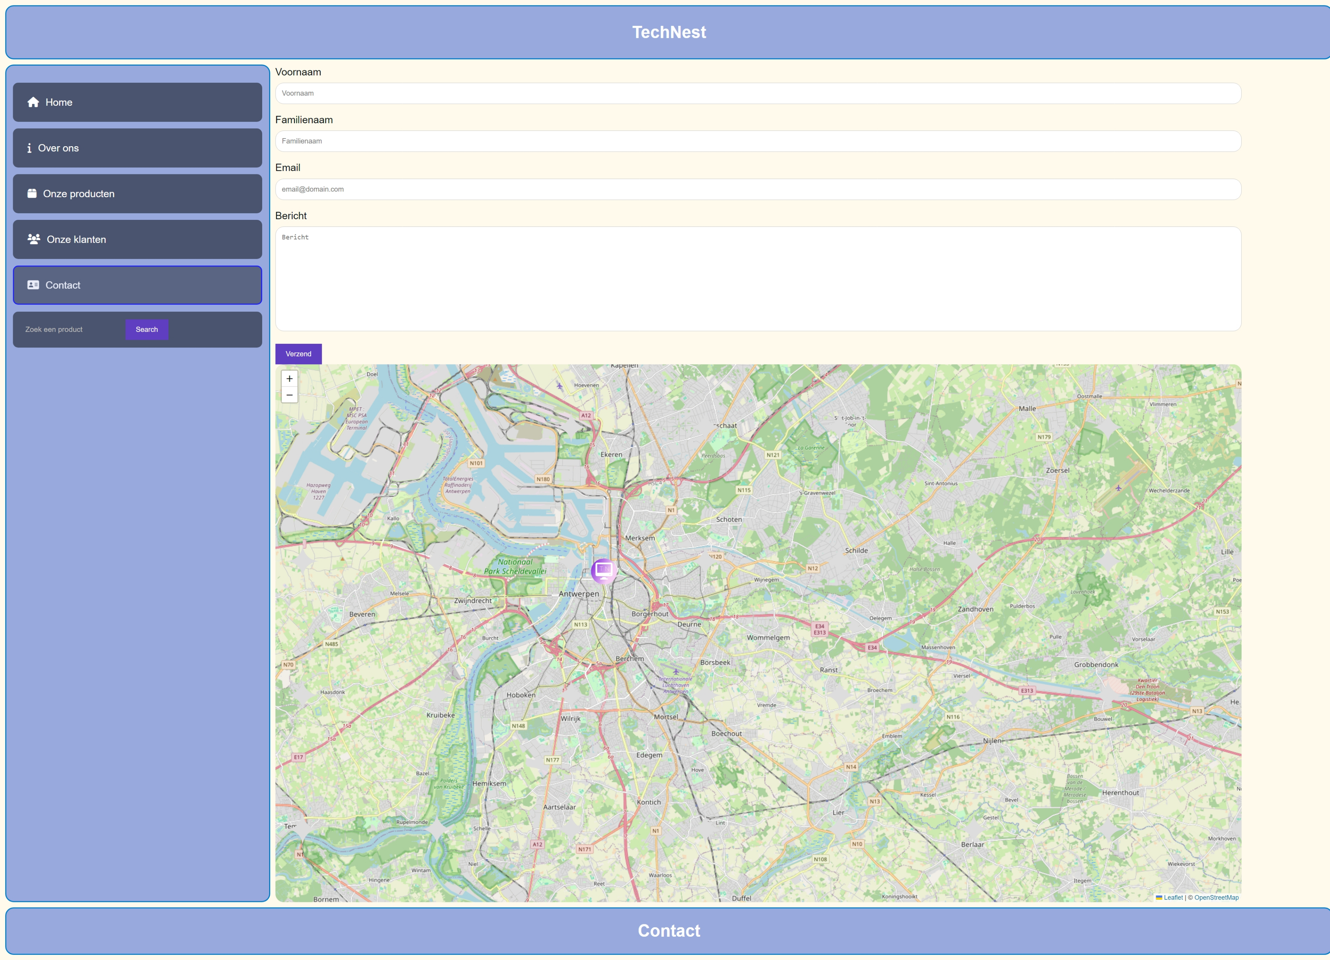
Contact Desktop

Slide 12
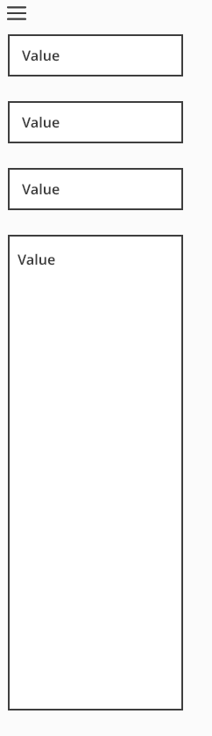
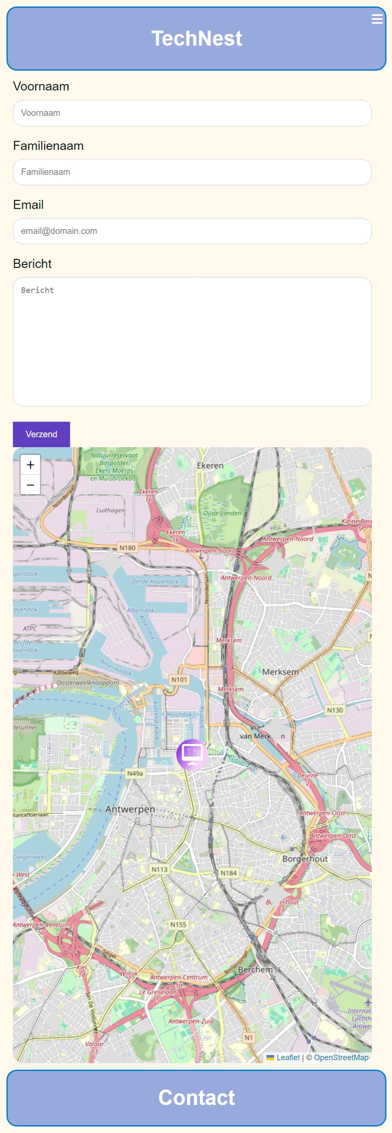
Contact Mobile

Slide 13

Einde

